Slide 1



INTELLIGENT NETWORK DEPLOYMENT SCHEME

Slide 2


Slide 3
PROBLEM STATEMENT
The predominant challenges within contemporary networks entail high operational costs, potential delays in manual deployment procedures, and the requisite expertise of highly skilled personnel. Maintenance challenges stem from the efficient management of diverse network traffic, necessitating sophisticated strategies for optimal handling.
To address these, we propose an Intelligent Network Deployment Scheme, presents a comprehensive approach encompassing requirement elicitation, topology design, and auto-provisioning, ensuring the network's preparedness for the integration of new services.

Slide 4
Purpose: The proposed intelligent network deployment scheme (INDS) aims to automate end-to-end network deployment, reducing operational costs, minimizing manual intervention, and enhancing deployment accuracy.
Scope: The INDS covers the entire deployment process, from collecting customer requirements and designing network topology to auto-provisioning network devices and generating feasibility reports.
Study of Existing System: Current network deployment processes are plagued by high costs, delays, and human errors, requiring extensive manual effort and technical expertise.

Slide 5


Slide 6
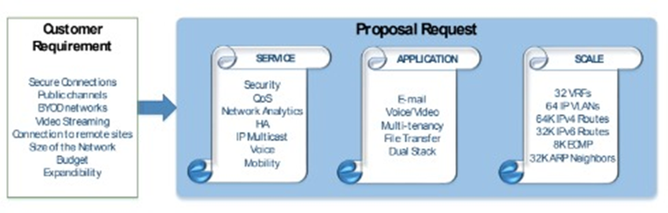
PROPOSED SOLUTION
Requirement Gathering
Collect data on business needs and network size.
Utilize Proposal Requests (PR) from customers containing network scale and required services.
Derive Network Templates based on PR details for each site.

Slide 7
INDS Auto-Provisioning
Translate PR into feature sets and select appropriate network hardware.
Use Aruba's campus switching portfolio for intelligent network foundation.
Automate device selection and configuration based on PR features.
Zero-touch provisioning for network device configuration without manual intervention.

Slide 8
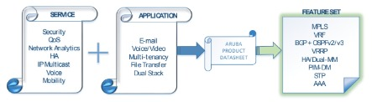
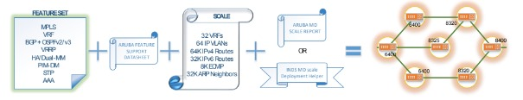

Slide 9
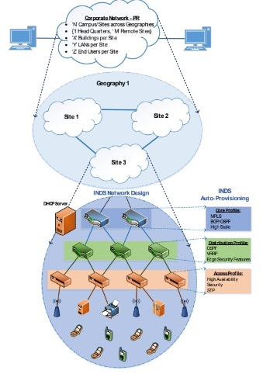

Slide 10
INDS Feasibility Report
Generate a report on feasibility and supportability for auto-derived network design.
Assess extensibility and flexibility of proposed design for scaling.
Highlight any gaps in product portfolio for requested network design.
INDS PR Violation Analytics
Pre-load device capacities during provisioning to prevent network instability.
Alerts for violations such as exceeding scale limits or unauthorized feature configurations.
Ensure adherence to INDS policies to prevent network disruptions.

Slide 11
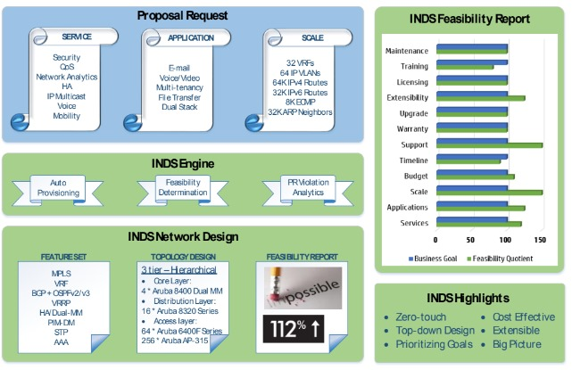
INDS ARCHITECTURE

Slide 12
APPROACH TO SOLUTION

Slide 13
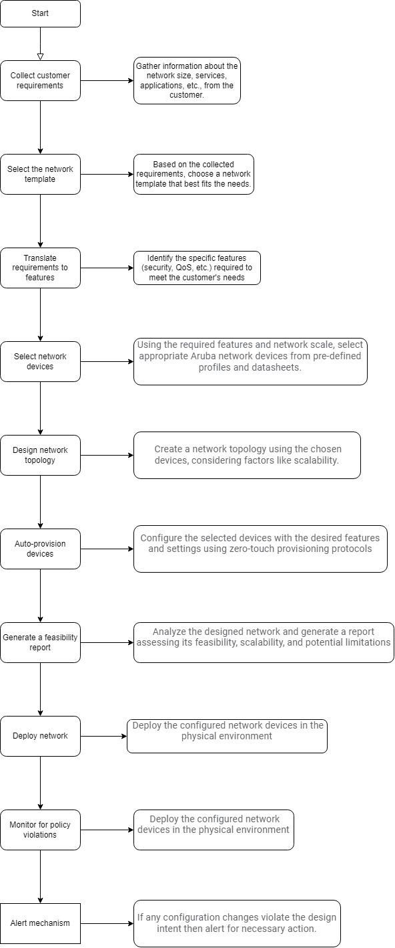

Slide 14
LET’S GET INTO THE CODE…

Slide 15
HOPE YOU UNDERSTOOD THE CODE WELL AND GOT THE OUTPUT AS PER YOUR EXPECTATION.
NOW, LET’S MOVE FURTHER…

Slide 16
Datasheets
Linux
Learnings
Python
Networking Concepts
Switches
Topologies
Protocols
Campus network topology

Slide 17
RESULT
The implementation of the Intelligent Network Deployment Scheme (INDS) led to a significant reduction in operational costs and deployment times. By automating the end-to-end network deployment process, the scheme minimized manual intervention, reducing human errors and the need for highly technical personnel. The automated feasibility report ensured that all customer requirements were met, while the PR Violation Analytics module provided ongoing monitoring to maintain network stability and compliance. Overall, the network deployment was more efficient, reliable, and scalable.

Slide 18
CONCLUSION
Efficiency and Cost Savings: INDS reduced deployment costs and time by automating hardware selection, configuration, and provisioning, eliminating traditional bottlenecks and errors.
Scalability and Flexibility: The solution can handle large, multi-site networks and adapts to new demands with automated feasibility reports and PR Violation Analytics.
Enhanced Reliability: Zero-touch provisioning and continuous policy violation monitoring promptly address potential issues, ensuring network reliability and service quality.

Slide 19
APPLICATIONS
CORPORATE NETWORKS
EDUCATIONAL INSTITUTIONS
SERVICE PROVIDERS
HEALTH CARE SYSTEMS
GOVERNMENT AND PUBLIC SECTORS

Slide 20
REFERNCES
Aruba CX 6100: https://www.hpe.com/psnow/doc/a00106853enw
Aruba CX 6300: https://www.hpe.com/psnow/doc/a00085162enw
Aruba CX 8325: https://www.hpe.com/psnow/doc/a00059009enw
Aruba CX 6400: https://www.hpe.com/psnow/doc/a00085158enw
Aruba CX 8360: https://www.arubanetworks.com/assets/ds/DS_8360Series.pdf

Slide 21


